Slide 1

Top 1000 MOVIES
Skip to content
February 3rd 2022
Data Analysis Bootcamp
Mango5 Project

Slide 2
Presented by
James Yoo
Samuel Park
Elliott Einstein
Sally Ahmed
Instructor: Anthony Taylor
TA: Mark Flynn
Data Analysist bootcamp
Project 1

Slide 3
General information
IMDB Rating
IMDB registered users can cast a vote (rating 1 to 10) on every released title in the database. Individual votes are then aggregated and summarized as a single IMDb rating, visible on the title's main page.
MetaScore
Rating of a film by large group of world’s most respected critics into a single number

Slide 4
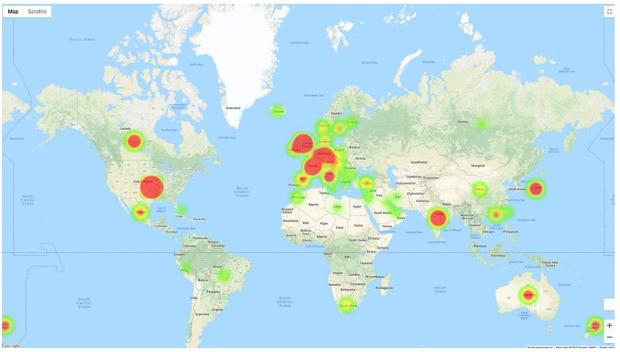

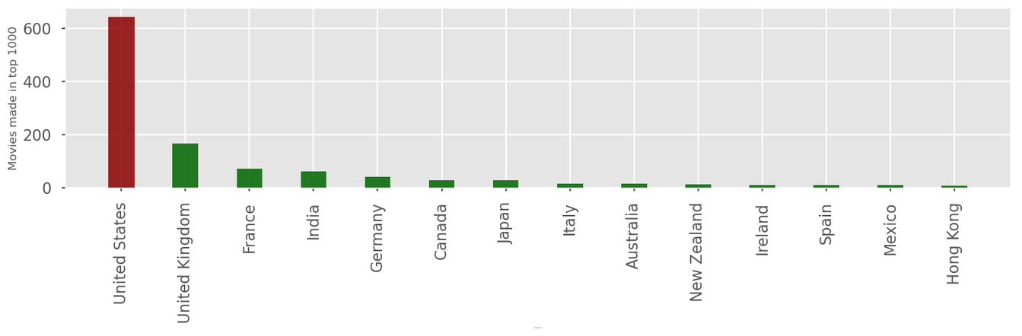

Where is the central hub of Movie production?

Slide 5
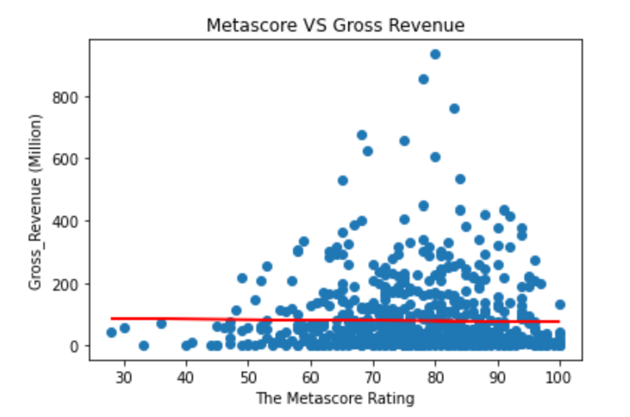
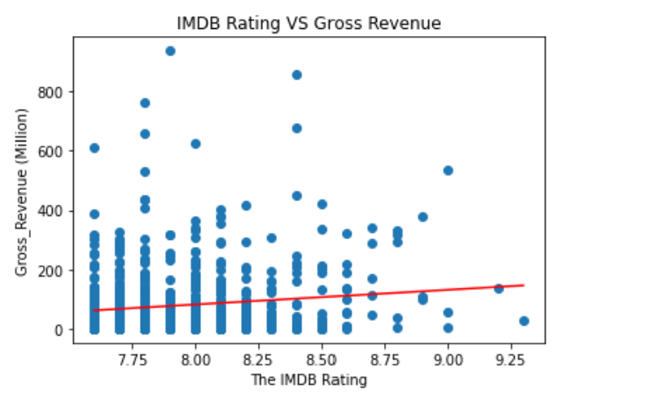
Does the IMDB Rating and Metascore have impact on the Gross Revenue?

Slide 6
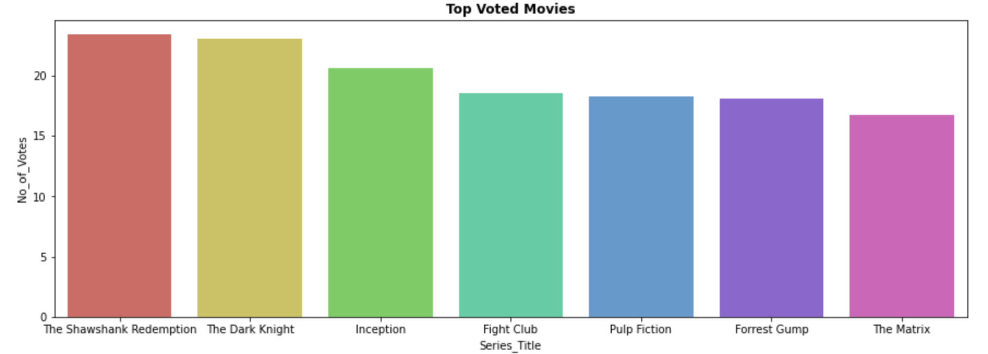

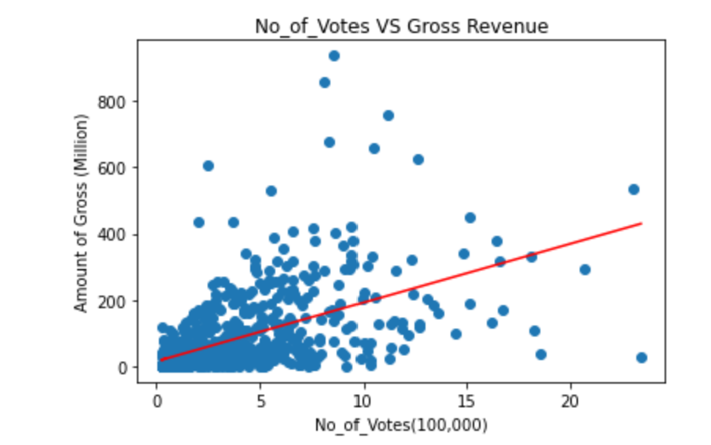
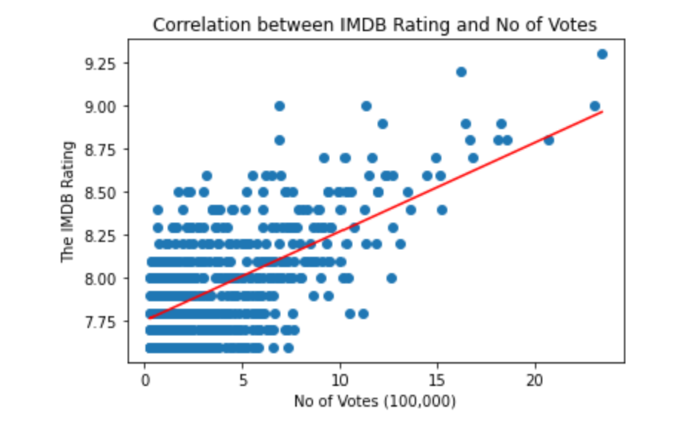

Do movies have higher gross revenue with more number of votes?

Slide 7
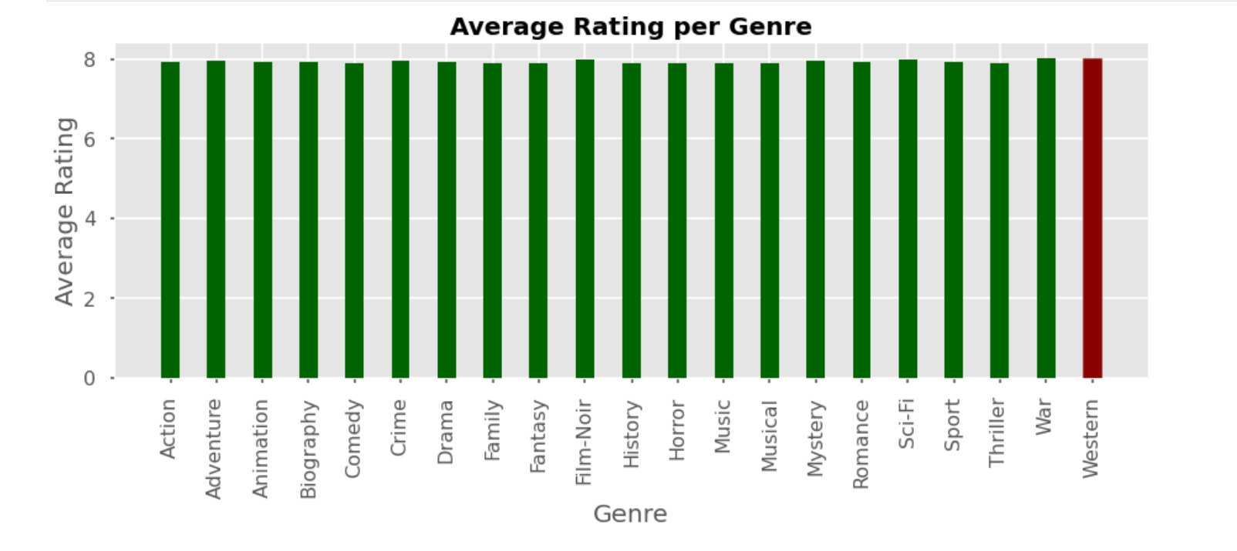
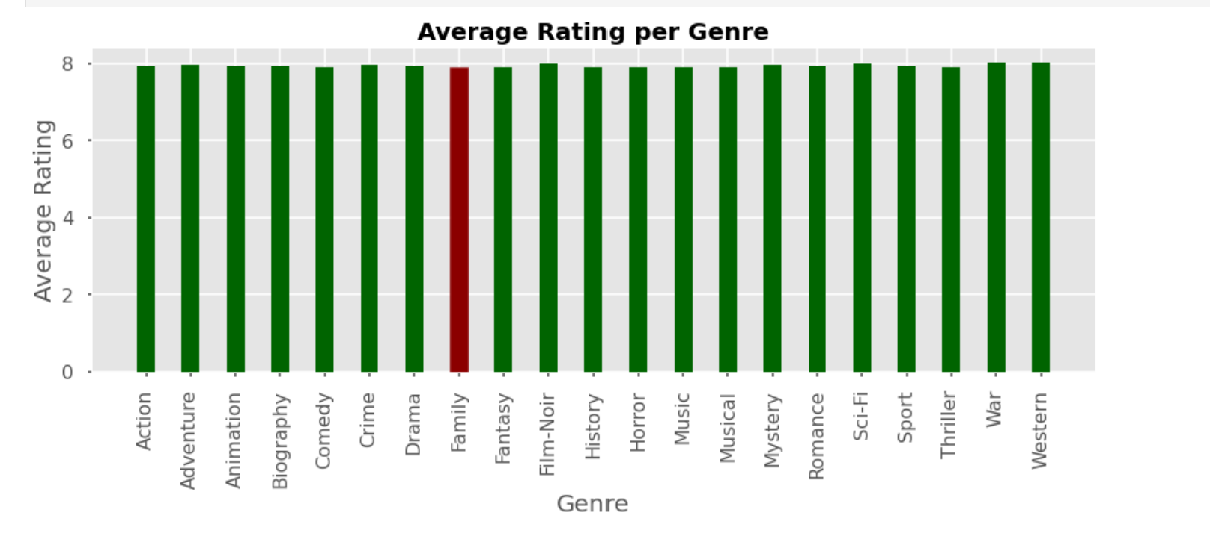
Which movie genre is the highest rated and which movie genre is the least rated?

Slide 8
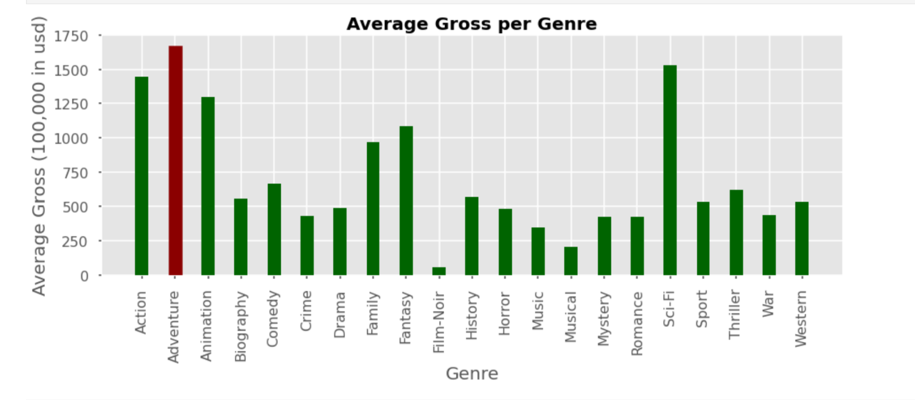
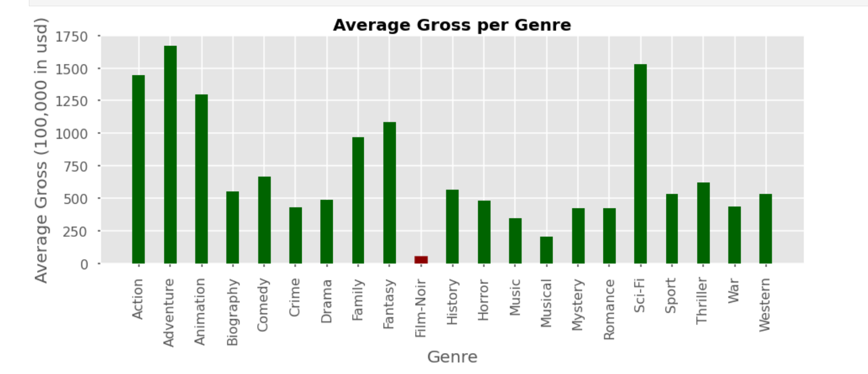
Which movie genre makes the highest gross income and which movie genre makes the least?

Slide 9
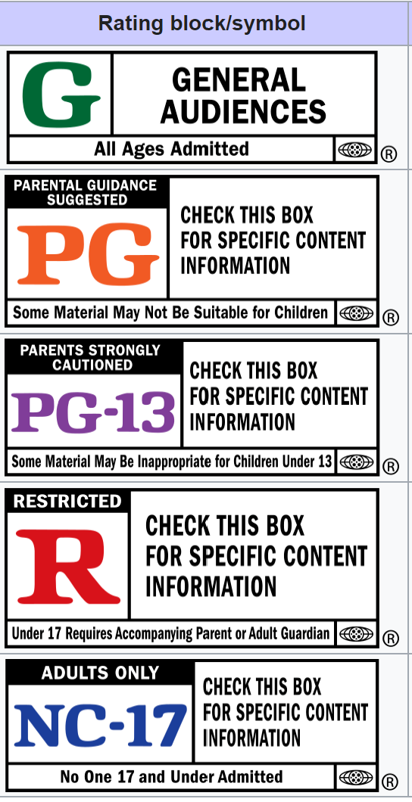
Movie Certificate
Motion Picture Association film rating system
G – General Audiences
PG – Parental Guidance Suggested
PG-13 – Parents Strongly Cautioned
R – Restricted
NC-17 – Adults Only

Slide 10
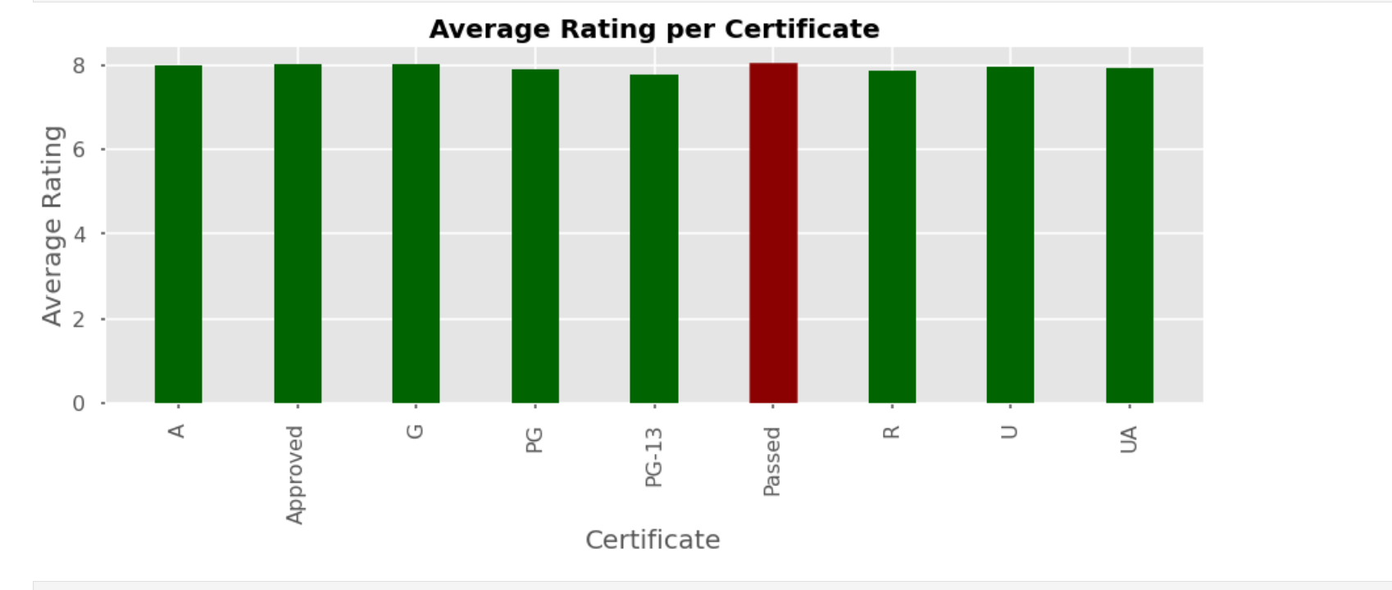
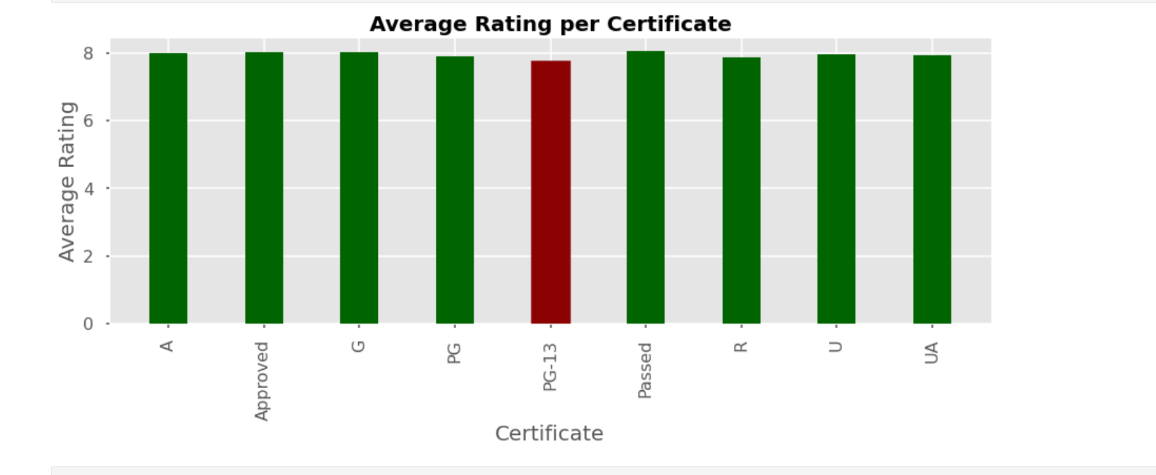
Which movie certificate is the highest rated and which movie certificate is the least rated?

Slide 11
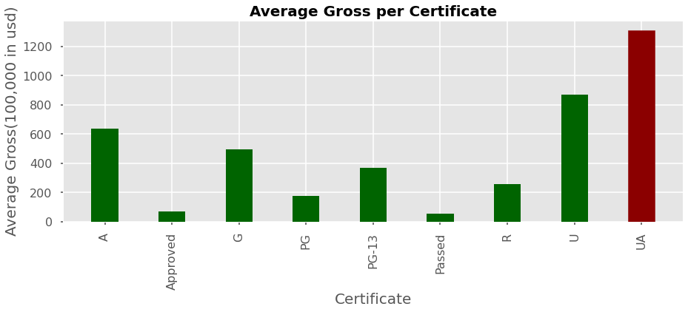
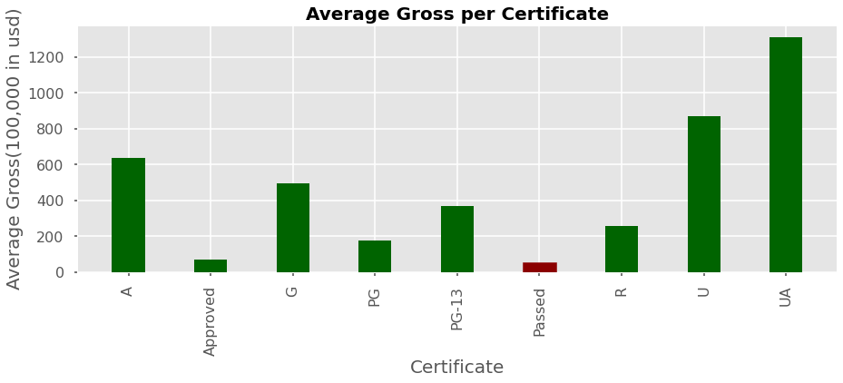
Which movie certificate makes the highest gross income and which movie certificate makes the least?

Slide 12
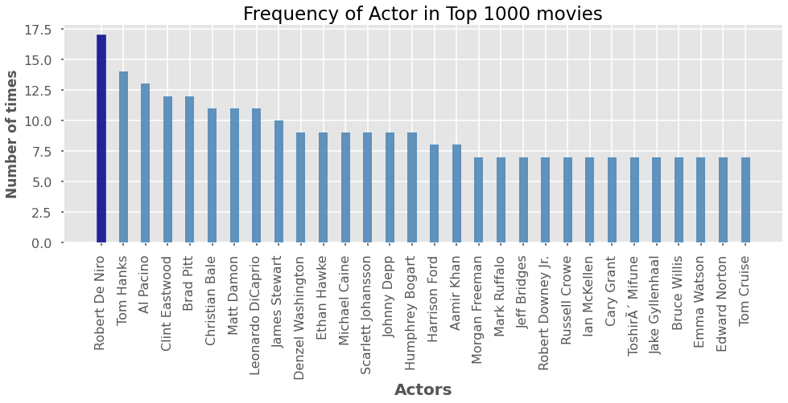
How often does each actor have been appeared?
Robert De Niro - 17
Tom Hanks - 14
Al Pacino - 13

Slide 13
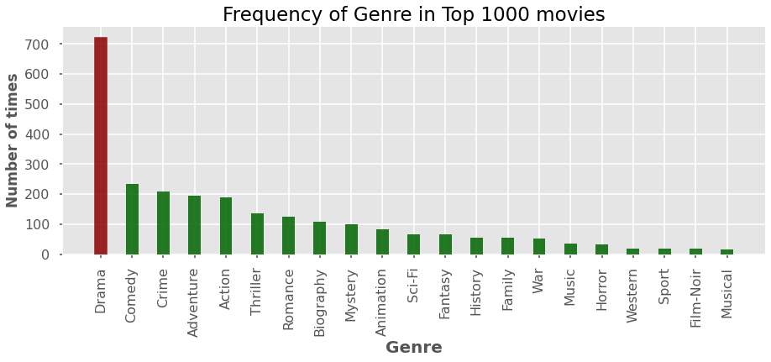
How often does each genre have been appeared?
Drama – 732
Comedy - 235
Crime – 217

Slide 14
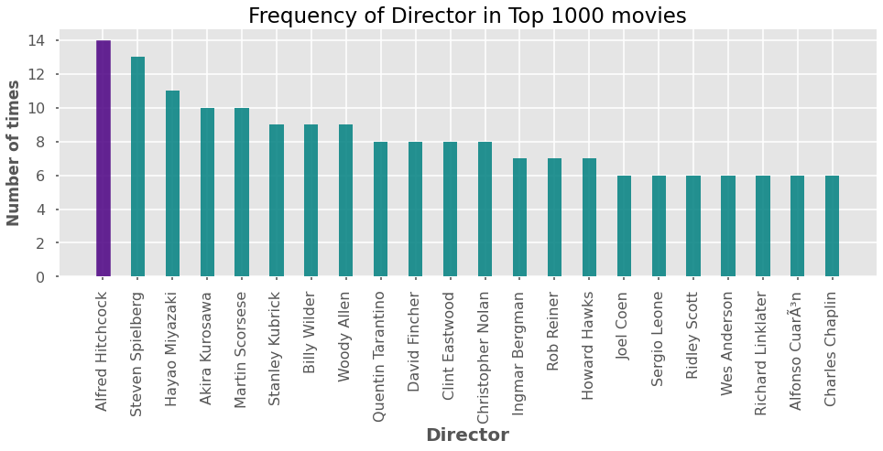
How often does each director have been appeared?
Alfred Hitchcock - 14
Steven Spielberg - 13
Hayao Miyazaki - 11

Slide 15
Movie Score Calculator
Genre Frequency -> 20%
Actor Frequency -> 40%
Director Frequency -> 40%
Predict score!

Slide 16
2010 Top 200 Movies
Top 1 - 10 | Score | Top 191 - 200 | Score
Avatar | 31.44 | Twilight/New Moon | 0.27
Toy Story 3 | 32.46 | Fantastic Mr. Fox | 21.7
Alice in Wonderland | 23.48 | Brothers | 17.04
Iron Man 2 | 20.98 | The White Ribbon | 8.93
The Twilight Saga: Eclipse | 18.76 | A Prophet | 8.11
Inception | 45.74 | Tamara Drewe | 4.61
Harry Potter and the Deathly Hallows: Part 1 | 32.05 | Harry Brown | 14.74
Despicable Me | 16.27 | Stone | 27.87
Shrek Forever After | 13.41 | The Road | 11.06
How to Train Your Dragon | 20.28 | Flipped | 13.61
Avg score | 25.49 | Avg score | 12.79

Slide 17
2015 Top 200 Movies
Top 1 - 10 | Score | Top 191 - 200 | Score
Jurassic World | 12.41 | Horrible Bosses 2 | 8.43
Star Wars: Episode VII | 20.03 | He Named Me Malala | 1.84
Avengers: Age of Ultron | 32.41 | Captive | 9.53
Inside Out | 23.88 | Chi-Raq | 31.16
Furious 7 | 11.23 | The interview | 11.41
American Sniper | 44.91 | Truth | 22.66
Minions | 17.22 | Mistress America | 19.05
The Hunger Games: Mockingjay | 9.55 | Pawn Sacrifice | 26.47
The Martian | 47.18 | The Oscar Nominated Short Films 2015: Live Action | 12.25
Cinderella | 23.18 | Meru | 0.32
Avg score | 24.2 | Avg score | 14.312

Slide 18
2020 Top 200 Movies
Top 1 - 10 | Score | Top 191 - 200 | Score
Bad Boys for Life | 12.58 | The Wolf of Snow Hollow | 6.16
1917 | 31.55 | Come Away | 16.68
Sonic the Hedgehog | 14.27 | The Good Liar | 24.13
Jumanji: The Next Level | 10.46 | And Then We Danced | 14.37
Star Wars: Episode IX - The Rise of Skywalker | 20.01 | Beanpole | 13.11
Birds of Prey | 12.36 | Follow Me | 5.53
Dolittle | 16.78 | Extra Ordinary | 6.55
Little Women | 26.75 | Palm Springs | 9.59
The Invisible Man | 14.47 | A Call to Spy | 18.58
The Call of the Wild | 25.09 | Love Story | 16.27
Avg score | 18.432 | Avg score | 13.097

Slide 19
2022 Top 61 Movies
Top 1 - 10 | Score | Top 52 - 61 | Score
Spider-Man: No Way Home | 9.54 | Italian Studies | 12.25
Scream | 2.22 | Alter Ego | 14.37
Sing 2 | 23.88 | The Hating Game | 6.06
The King's Man | 23.12 | The Novice | 14.57
The 355 | 7.42 | Luzzu | 12.25
American Underdog | 15.37 | A Taste of Hunger | 14.37
The Matrix Resurrections | 10.05 | Simple Passion | 14.37
West Side Story | 22.74 | Bringhton 4th | 5.77
Redeeming Love | 16.27 | Golden Voices | 18.31
Licorice Pizza | 32.59 | The Battle at Lake Changjin | 19.25
Avg score | 16.32 | Avg score | 13.157

Slide 20
Prediction for the upcoming movies
Movies release on Feb 4 | Prediction Score
Last Survivors | 3.45
Moonfall | 8.58
The Long Night | 18.29
The Wolf and the Lion | 2.85

